Slide 1

BANK MARKETING
Presented by
Velammal

Slide 2
Topics
Marital status
Age Analysis
Age bracket of customers
Average duration of contacts
Mean balance and Subscription

Slide 3

MARITAL STATUS
Using a BAR CHART,
I have shown the average age of customers grouped by martial status contacted by marketing teams

Slide 4
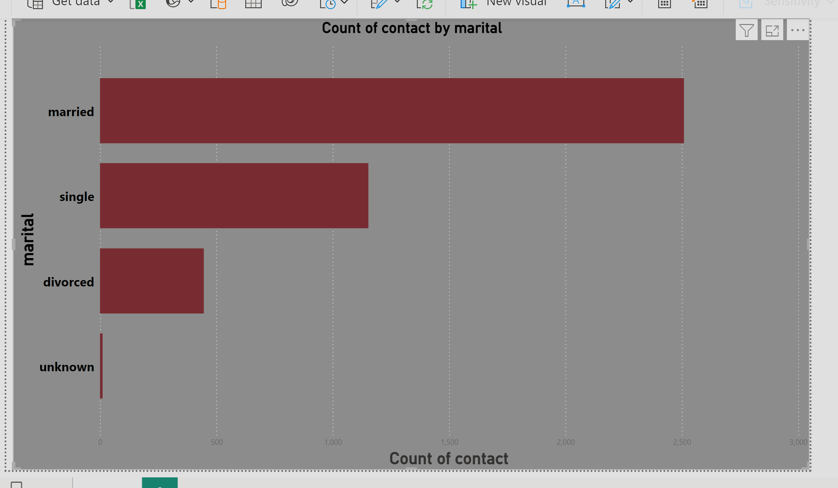
INTERPRETATION From this we can understand married people are highly contacted by the marketing team members among others.

Slide 5

AGE ANALYSIS
In this chart, I have shown the age analysis (i.e. Mean, Median, Mode) of the customers which are grouped by the education categories.

Slide 6
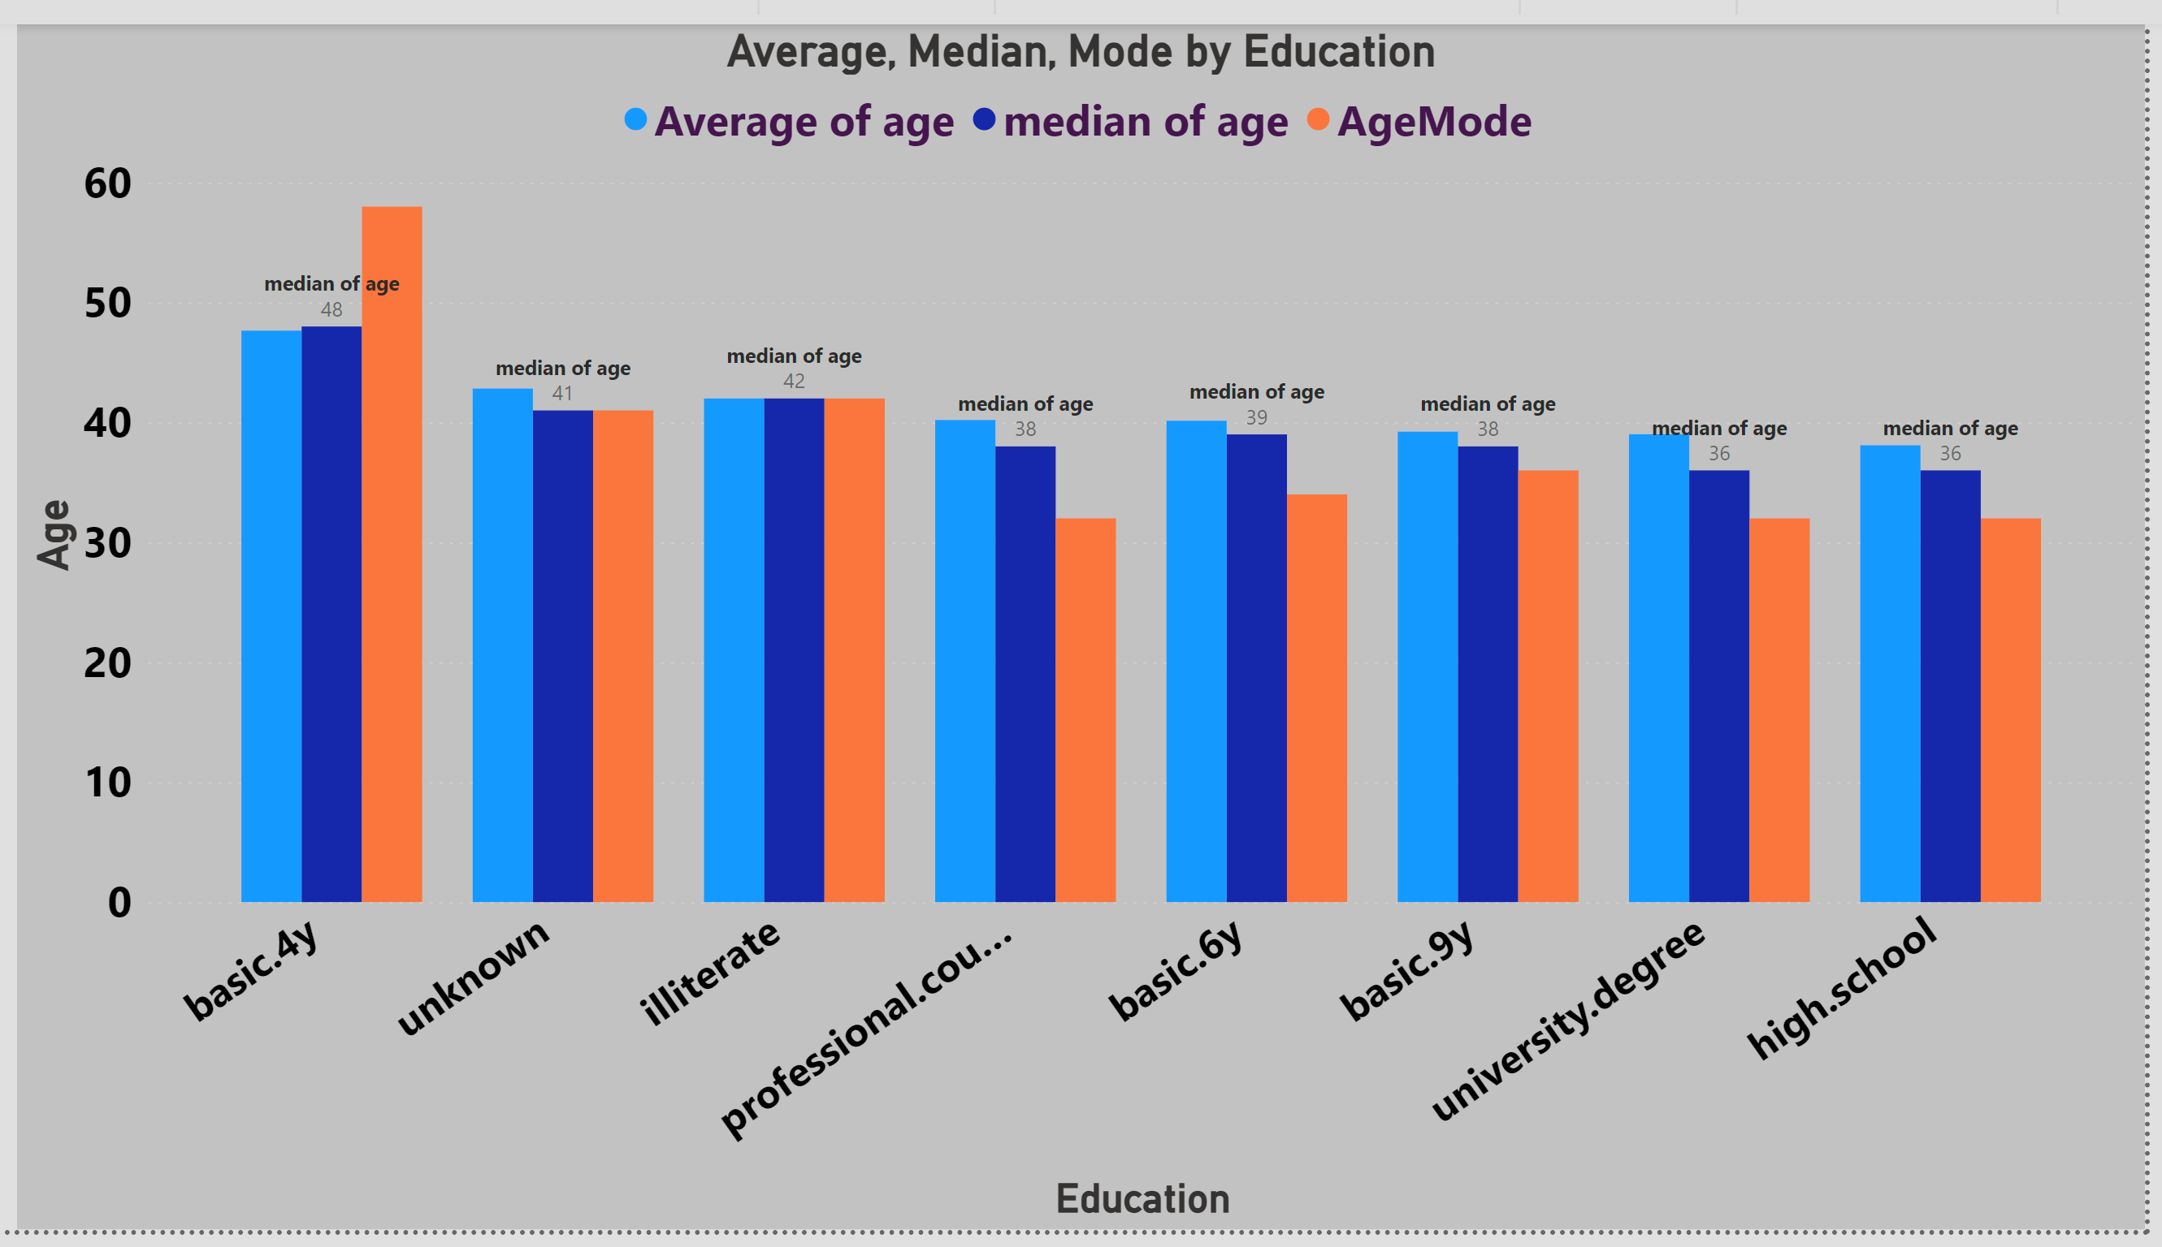

Slide 7
INTERPRETATION
EDUCATION | MEAN (AVERAGE) | MEDIAN | MODE
BASIC 4Y | 47.66 | 48.00 | 58.00
UNKNOWN | 42.83 | 41.00 | 41.00
ILLITERATE | 42.00 | 42.00 | 42.00
PROF COURSE | 40.21 | 38.00 | 32.00
BASIC 6Y | 40.14 | 39.00 | 34.00
BASIC 9Y | 39.23 | 38.00 | 36.00
UNIV DEG | 39.02 | 36.00 | 32.00
HIGH.SCHOOL | 38.10 | 36.00 | 32.00

Slide 8
AGE BRACKET OF CUSTOMERS
In this chart, I have shown which age group has highest number of customers contacted by the bank.

Slide 9
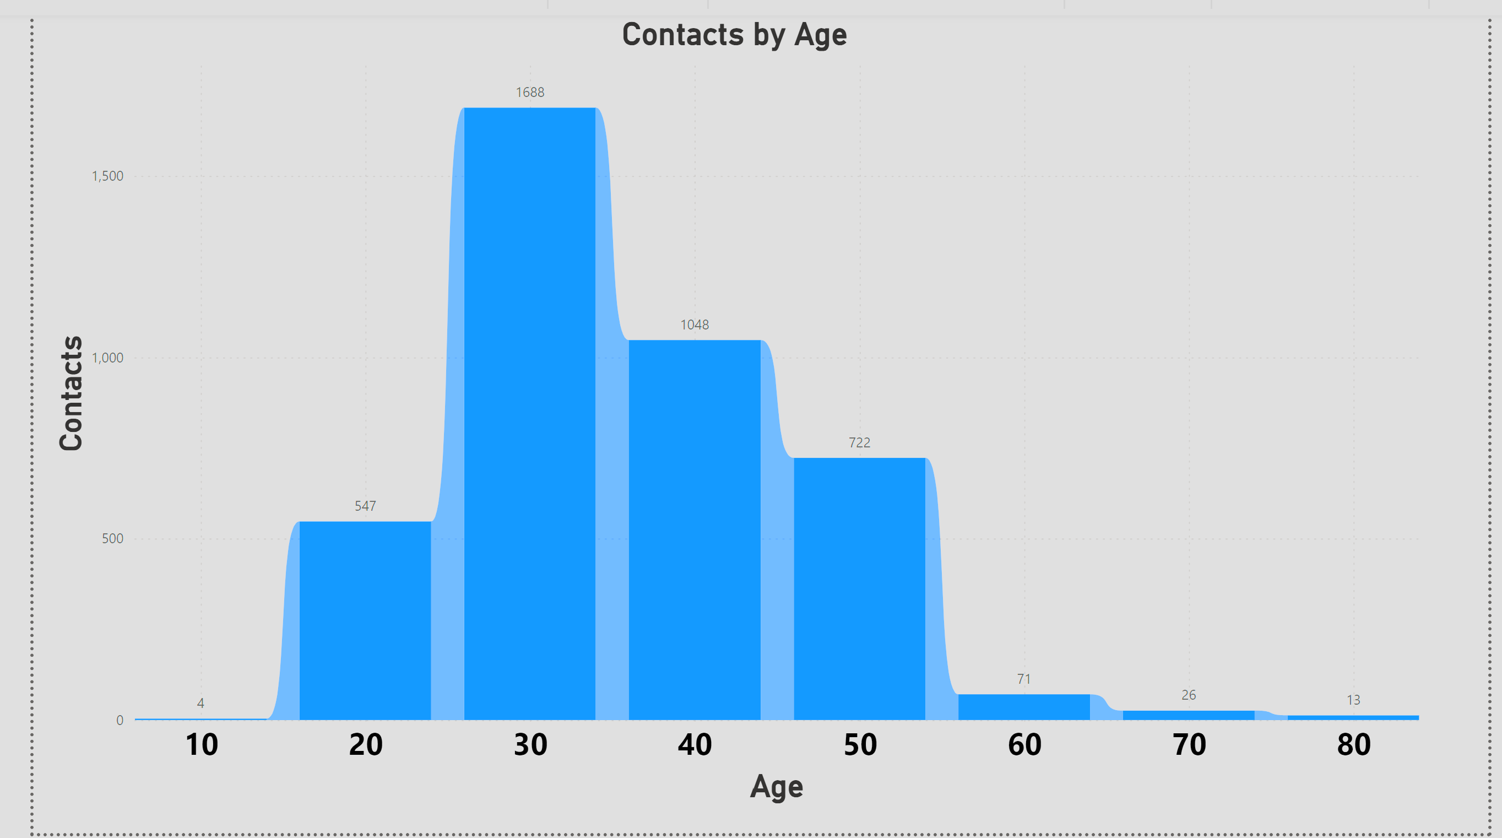
INTERPRETATION In this chart, 1688 people in the age group of 30 are highly contacted than other age group.

Slide 10

AVERAGE DURATION OF CONTACTS
Here, I have shown average of duration of cellular and unknown contacts

Slide 11
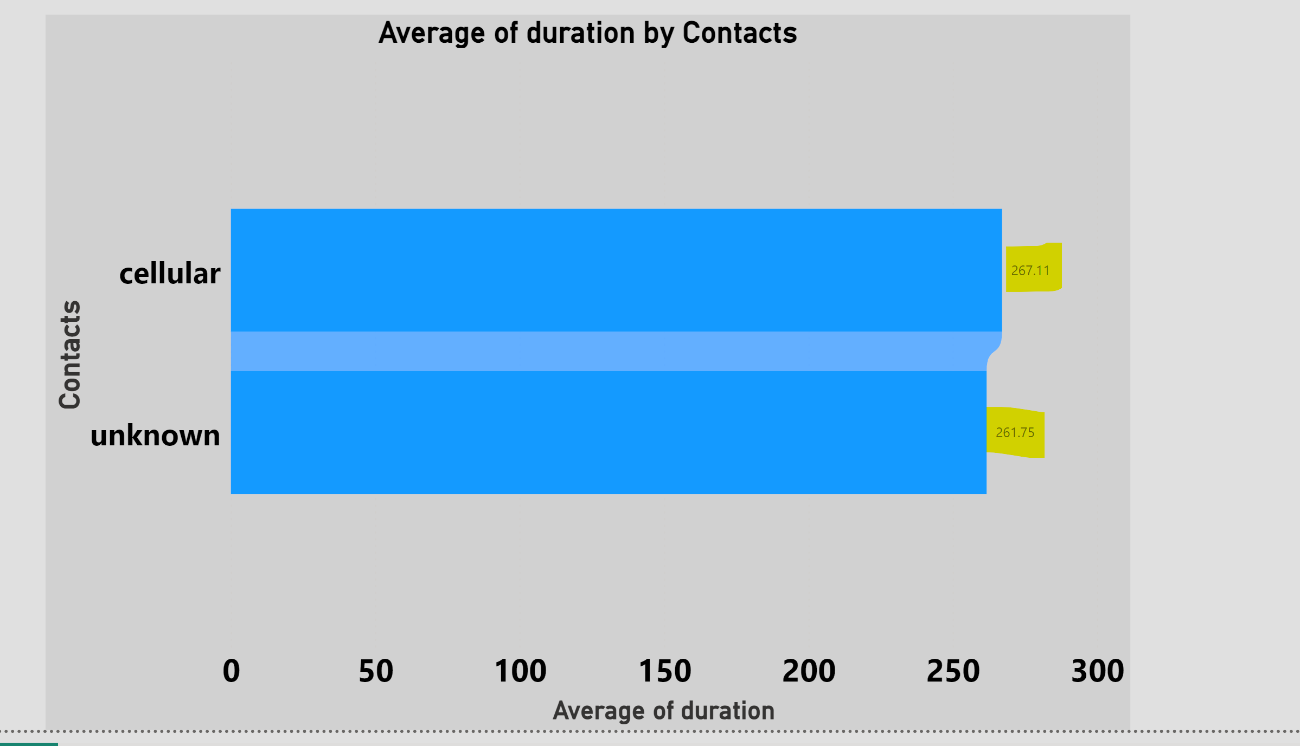
INTERPRETATION This chart represents the average duration of cellular and unknown contacts. The average duration of cellular contact is 267.11

Slide 12
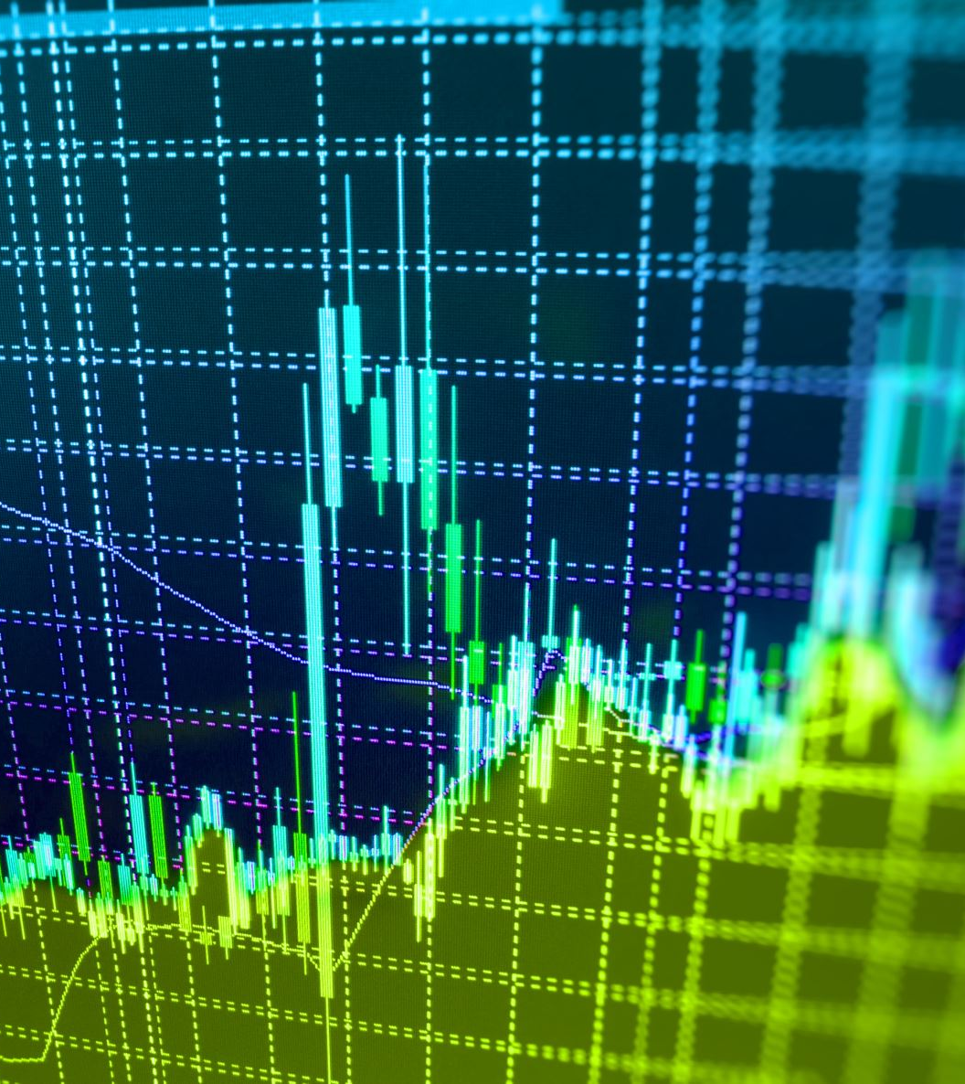
MEAN BALANCE AND SUBSCRIPTION
In this chart, I explained about the subscriptions and mean balance
Number of customers subscribed above mean balance
Number of customers not subscribed when they have above the mean balance
Number of customers subscribed below mean balance
Number of customers not subscribed when they have below the mean balance

Slide 13
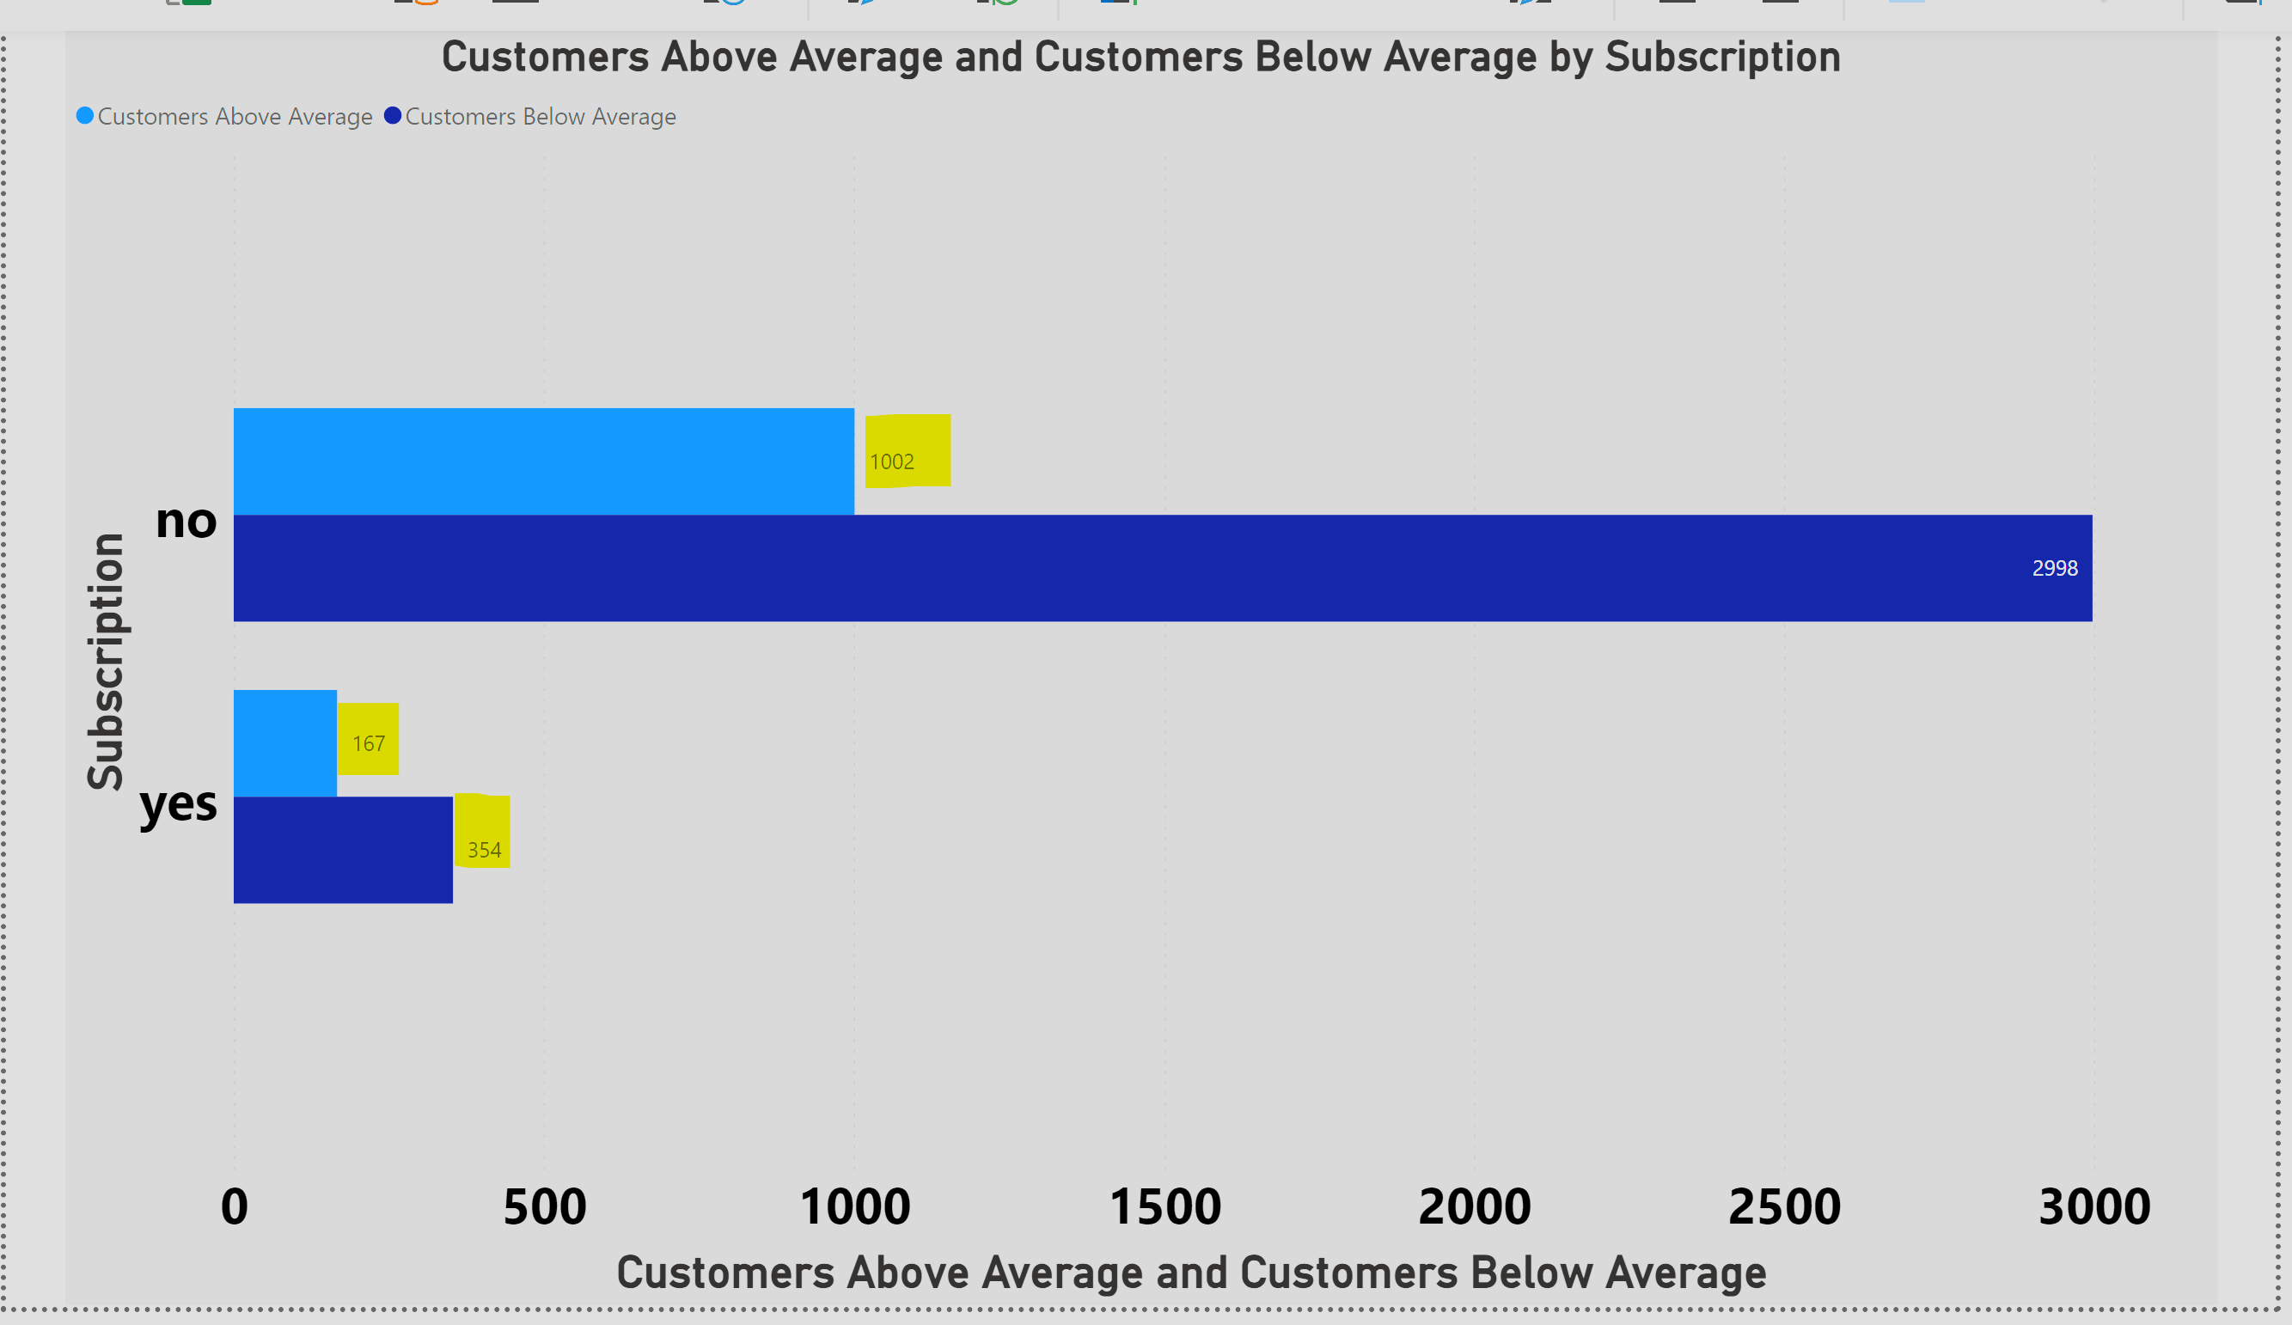
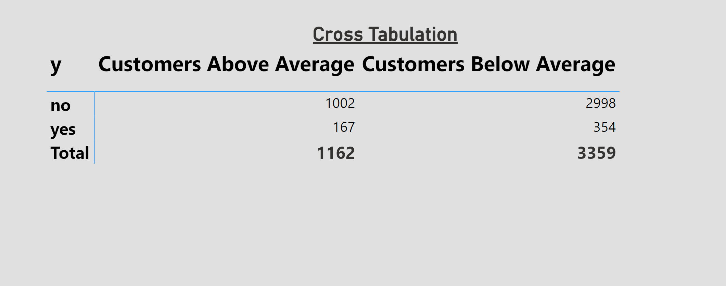
INTERPRETATION From this chart, we can understand 167 people are subscribed above mean the balance 354 people are subscribed below the mean balance 1002 people are not subscribed above the mean balance 2998 people are not subscribed below the mean balance

Slide 14
THANK YOU

